Slide 1
Data Encoders
Score Prediction and Commentary Sentiment analysis

Slide 2
Contents
Data Source
Data Extraction
Data Analysis
Data Visualization
Demo

Slide 3
Commentary sentiment analysis

Slide 4
Work Division
Data extraction: Raghunandan Kumar Naishadam
Analysis of Commentary: Dheeraj Edupuganti

Slide 5
Data Source
We are considering data from the web source known as www.crickbuzz.com to analyze the commentary for that cricket match.

Slide 6
Data extraction
Commentary data will be extracted using a python package called “pycricbuzz”

Slide 7
Data Analyzing and Visualization
Data Analysis is done by using a python package called as NLTK which results in score.
Based on the score emojis will be generated and will be displayed in Jupyter notebook.
The sentiment Analysis is performed based on polarity scores. i.e., positive and negative scores
The emoji's will vary depending on the polarity scores.

Slide 8
Demo

Slide 9
Score Estimation

Slide 10
Work Division
Implementation of Kafka and data extraction: Raghunandan Kumar Naishadam dan
Connecting MongoDB to PowerBI : Nikitha Kethireddy
Data Transformations: Deepthi Chokka
Data Visualization: Jeevan

Slide 11
Data Source
We are fetching the data from the API provided by www.crickbuzz.com to perform data visualization.

Slide 12
Steps of Data Extraction
Run zookeeper kafka and mongodb server
run the producer and consumer from the project in java ide.
Connect mongodb to powerbi and visualize the data

Slide 13
Data Connector
We will be using ODBC connection by following the instructions in the link https://www.progress.com/blogs/mongodb-odbc-driver-for-data-integration-with-power-bi

Slide 14
Data Analyzing and Transformation
Perform operations
perform group-by operation upon the unique id generated
Find maximum score
Calculate run rate of the team by dividing score with overs.
Calculate estimated score

Slide 15
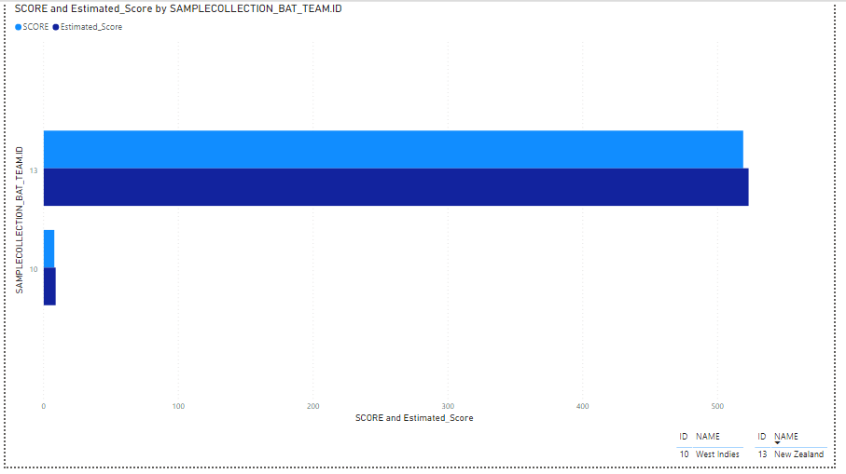
Data Visualization
We will be visualizing the data using Power BI.
The data will be visualized as the image shown.

Slide 16
Demo

